Slide 1
Selecting Directors Using Machine Learning
Isil Erel, Léa H. Stern, Chenhao Tan, & Michael S. Weisbach (2021)
Presented by Nicholas Thompson

Slide 2
Research Question
Can algorithms assist firms in their decisions on nominating corporate directors?

Slide 3
Prior Literature
There is much variation in director quality and the extent to which they serve shareholders’ interests (Hermalin & Weisbach, 2003; Adams, Hermalin, & Weisbach, 2010; Adams, 2017).
Many of the concerns about boards come from the director selection process, which is one of the most important yet least studied questions in corporate governance.
Berle and Means (1932) originally raised concerns about the director selection process.
Hermalin and Weisbach (1998) present a formal model in which directors are not selected optimally from shareholders’ perspectives.
Shivdasani and Yermack (1999), Kramarz and Thesmar (2013), and Cai, Nguyen, and Walkling (2017) provide evidence supporting this view.
Director reelections appear to affect a firm’s real activities, even if the elections are not contested and the nominated directors are reelected (Fos, Li, & Tsoutsoura, 2018; Aggarwal, Dahiya, & Prabhala, 2017; Ertimur et al., 2018).

Slide 4
Data
Large, publicly traded, U.S. firms with an average market capitalization of $6.6 billion.
41,015 new independent directors appointed to 4,887 unique corporate boards between 2000 and 2014 using BoardEx.
Level of shareholder support for individual directors from ISS Voting Analytics.
Excess votes: To construct this measure, they start with the number of votes in favor over all votes cast. They then subtract the average for the slate of directors up for reelection on that board and take the average of this variable over the first 3 years of tenure. Their sample contains the voting outcome for 24,054 new director appointments.

Slide 5
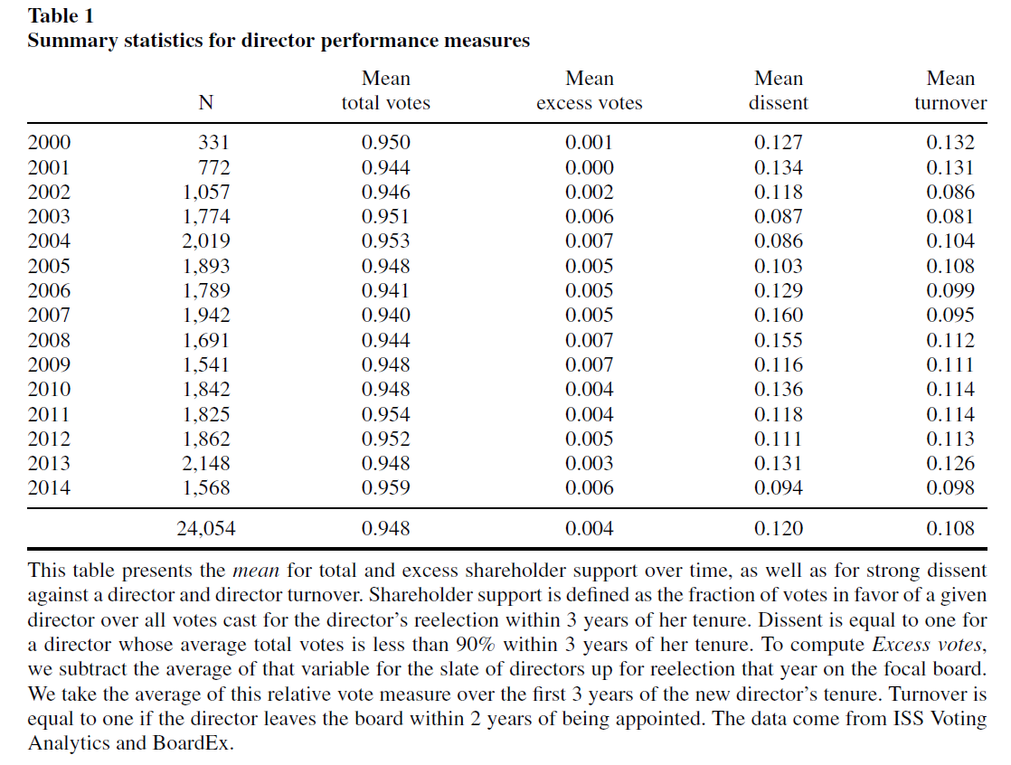
Notes:
Shareholder support is defined as the fraction of votes in favor of a given director over all votes cast for the director’s reelection within 3 years of her tenure.
Dissent is equal to one for a director whose average total votes is less than 90% within 3 years of her tenure.
To compute Excess votes, the authors subtract the average of that variable for the slate of directors up for reelection that year on the focal board. The authors take the average of this relative vote measure over the first 3 years of the new director’s tenure.
Turnover is equal to one if the director leaves the board within 2 years of being appointed.

Slide 6
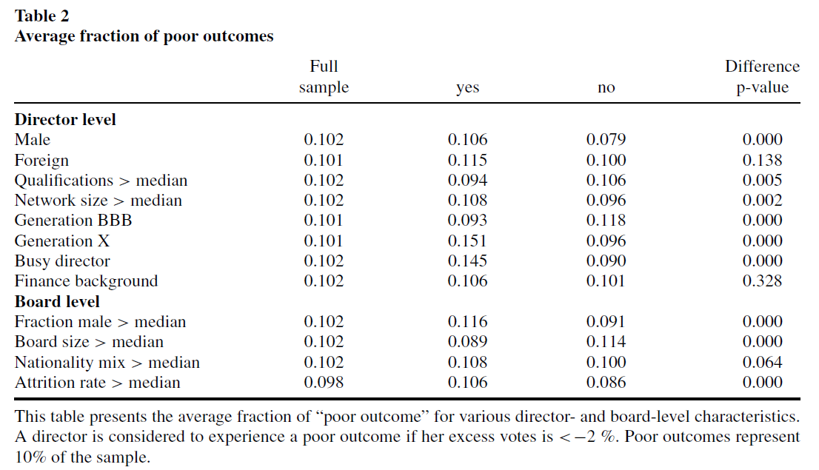
Notes:
The fraction “poor outcomes,” representing the bottom 10% of the sample in terms of excess votes, is 10.6% for male directors and 7.9% for female directors.
Similarly, busy directors (serving on three or more boards) experience low shareholder support more frequently than non-busy directors.

Slide 7
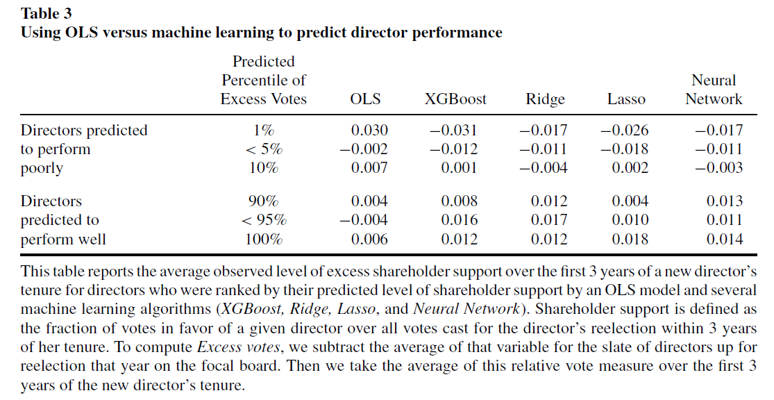
Notes:
Average observed shareholder support increases across model-predicted performance percentiles for each machine learning model. In contrast, in the OLS model, there is no relation between predicted and actual director performances.
XGBoost and Lasso perform best at predicting the subsequent success of directors using excess votes. Directors predicted to be in the bottom percentile as predicted by XGBoost and Lasso have an average observed excess shareholder support of −3.1% and −2.6%, respectively, whereas the average observed excess support is 1.2% and 1.8% for directors in the top percentile of predicted performance.

Slide 8
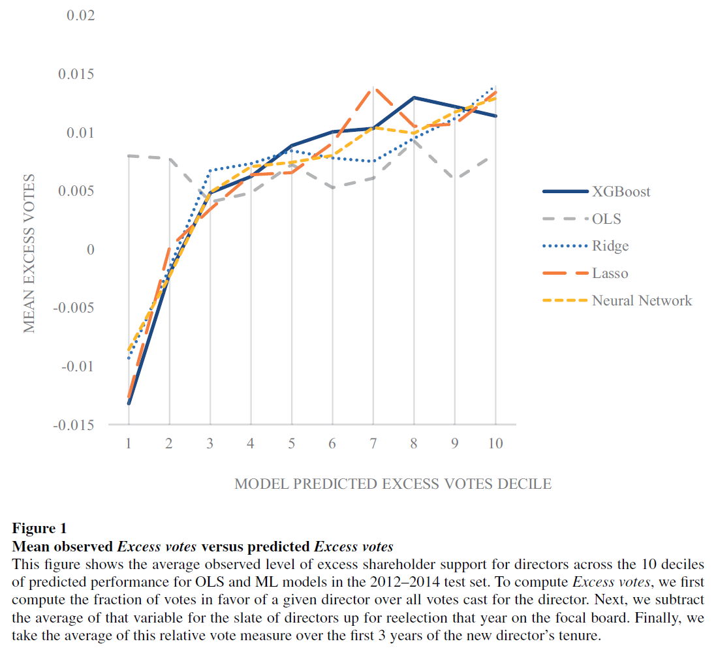
Notes:
The figure documents that the mean shareholder support for a director is an increasing function of predicted support for all the machine learning algorithms, but not for the OLS model.

Slide 9
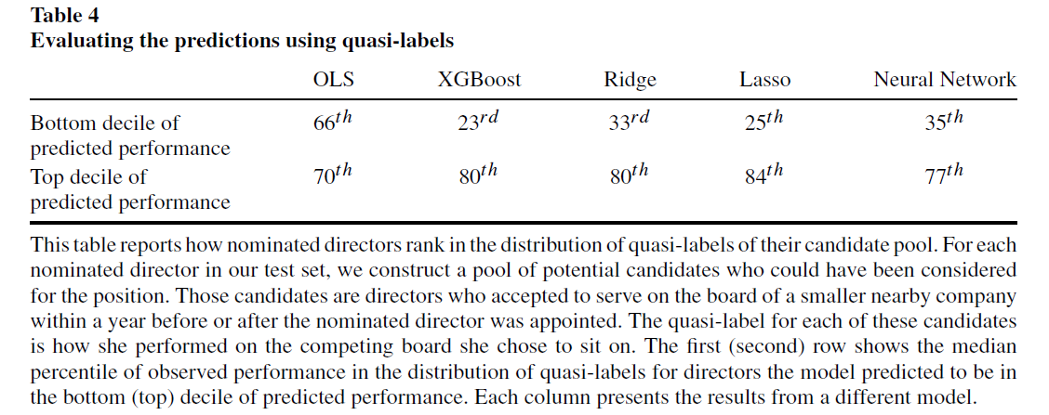
Notes:
For all machine learning models, nominated directors predicted to do poorly performed noticeably worse than available promising candidates, while nominated directors predicted to do well performed better than available unpromising alternative candidates.
In contrast, the predictions from the OLS model are uninformative about subsequent performance relative to available alternative candidates.

Slide 10
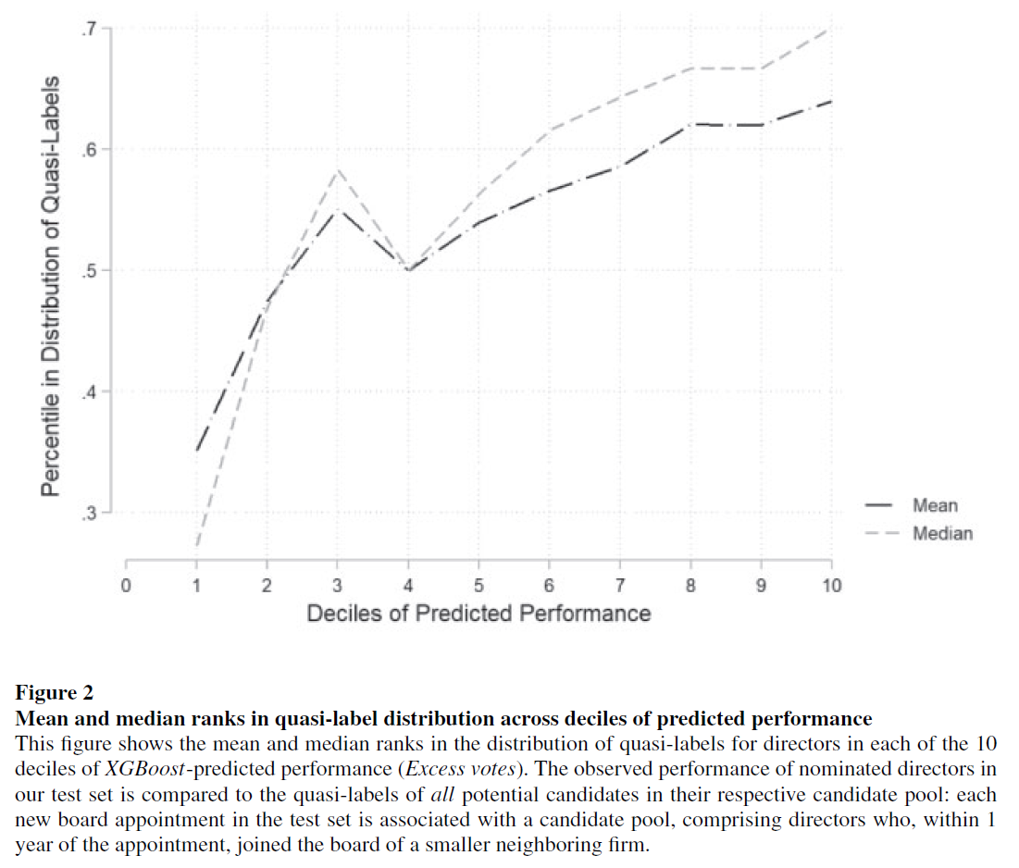
Notes:
Using the predictions from the XGBoost algorithm, the mean and median percentile rank in the distribution of quasi-labels increase almost monotonically across deciles of predicted performance. This suggests that as the algorithm’s prediction of a director’s performance increases, her effective percentile rank when compared to plausible candidates increases.

Slide 11
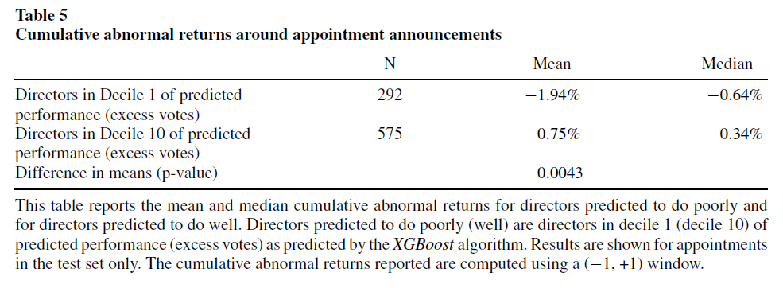
Notes:
The authors find that the mean CAR for directors predicted to do poorly (decile 1) in our test set is −1.94% whereas it is +0.75% for directors predicted to do well (decile 10).
Directors predicted to be unpopular also tend to be viewed by the market as worse directors.

Slide 12
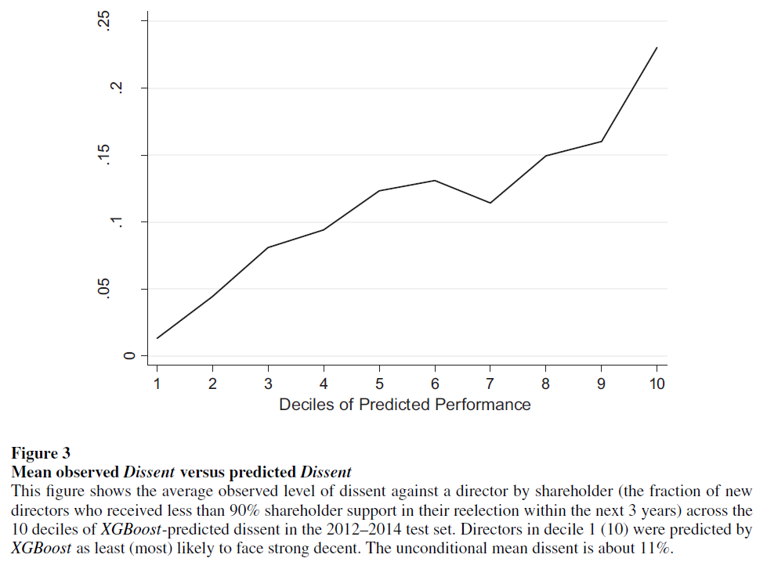
Notes:
The authors find that only 1.3% of directors in the bottom decile of predicted dissent (i.e., directors the algorithm predicted had the lowest chance of receiving less than 90% support) face strong dissent from shareholders. This ratio increases to 23% for directors in the top decile of predicted dissent.

Slide 13
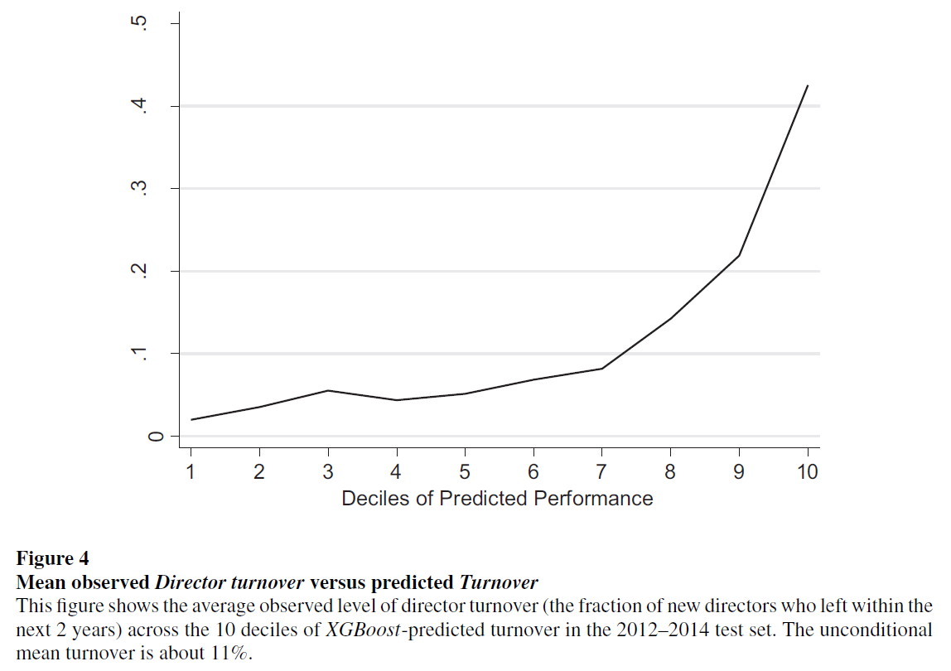
Notes:
Figure 1 documents a clear monotonically increasing relationship between the average fraction of directors who departed within 2 years in the test sample and the algorithm’s predictions.
While less than 2% of directors in the bottom decile leave within 2 years, this fraction increases to 43% in the top decile.

Slide 14
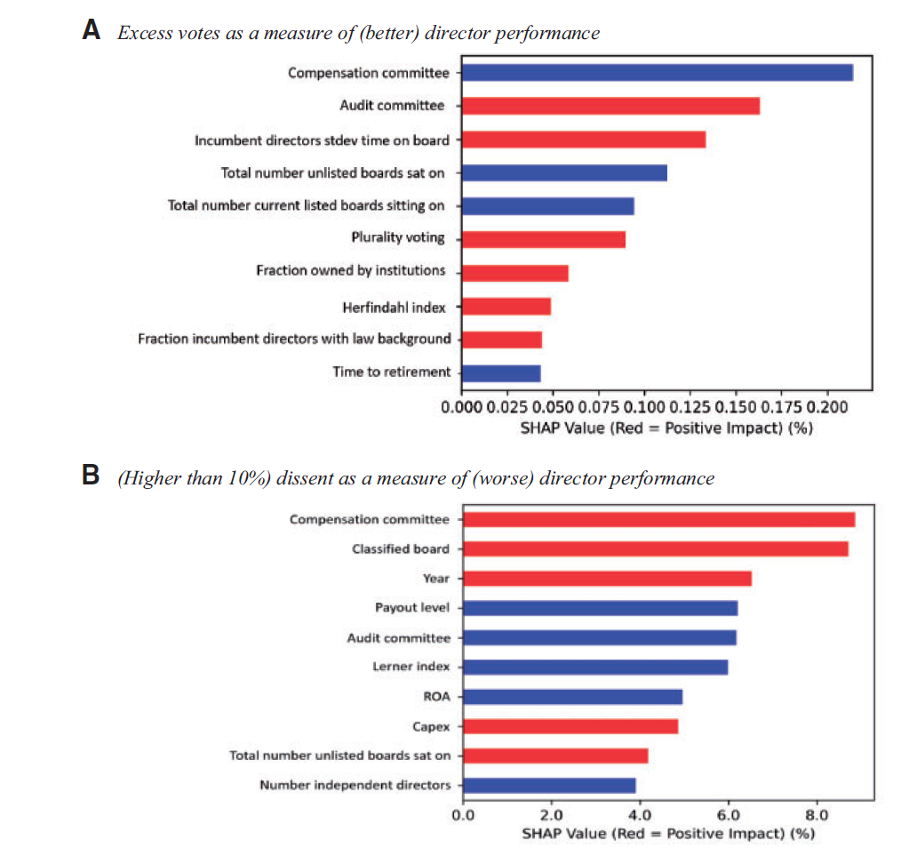
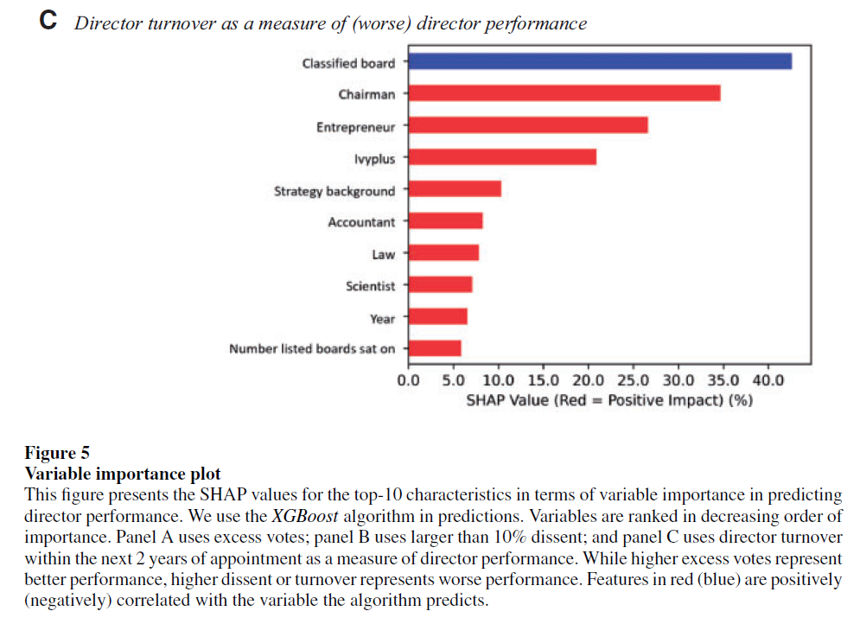
Notes:
Panel A example: Being a member of the compensation committee decreases the excess vote prediction by 0.22% on average, while being on the audit committee increases it on average by 0.16%.
Panel C: Mostly individual director characteristics appear to explain turnover predictions.

Slide 15
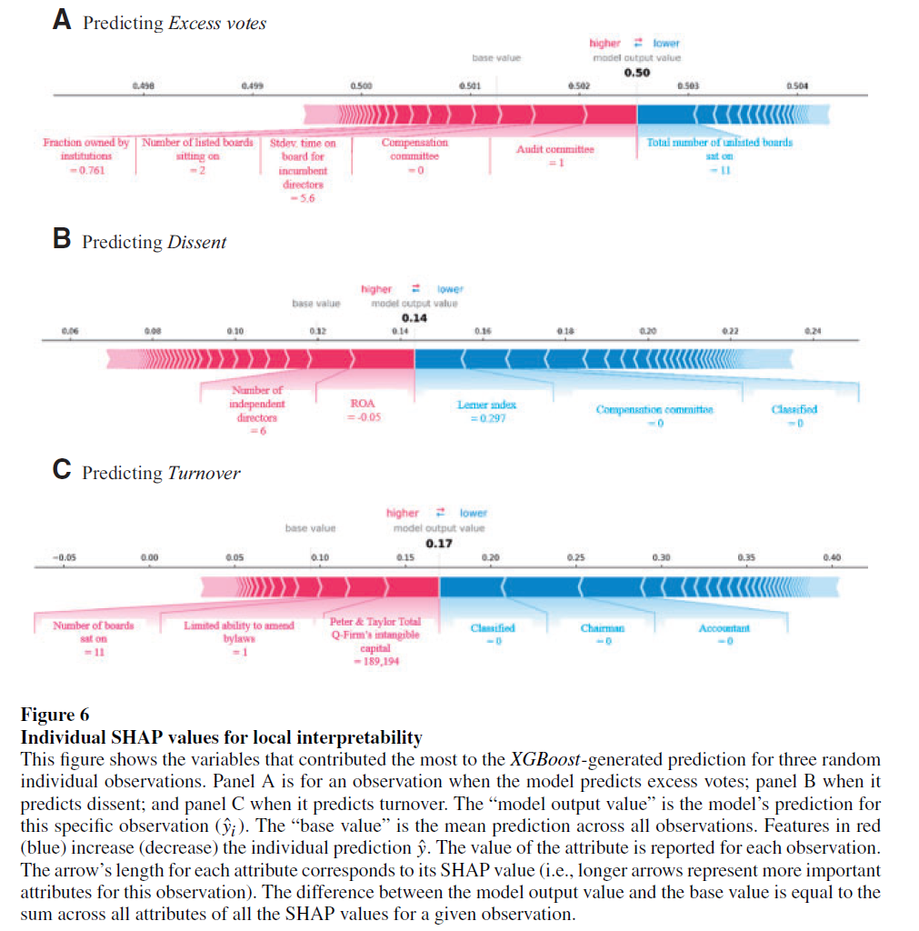

Slide 16
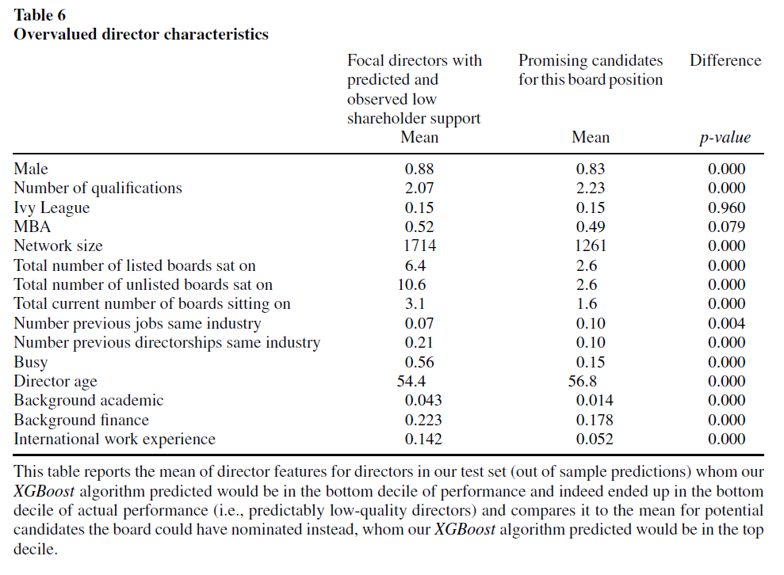
Notes:
Predictably unpopular directors are on average more likely to be male, have a larger professional network and more current and past directorships.

Slide 17
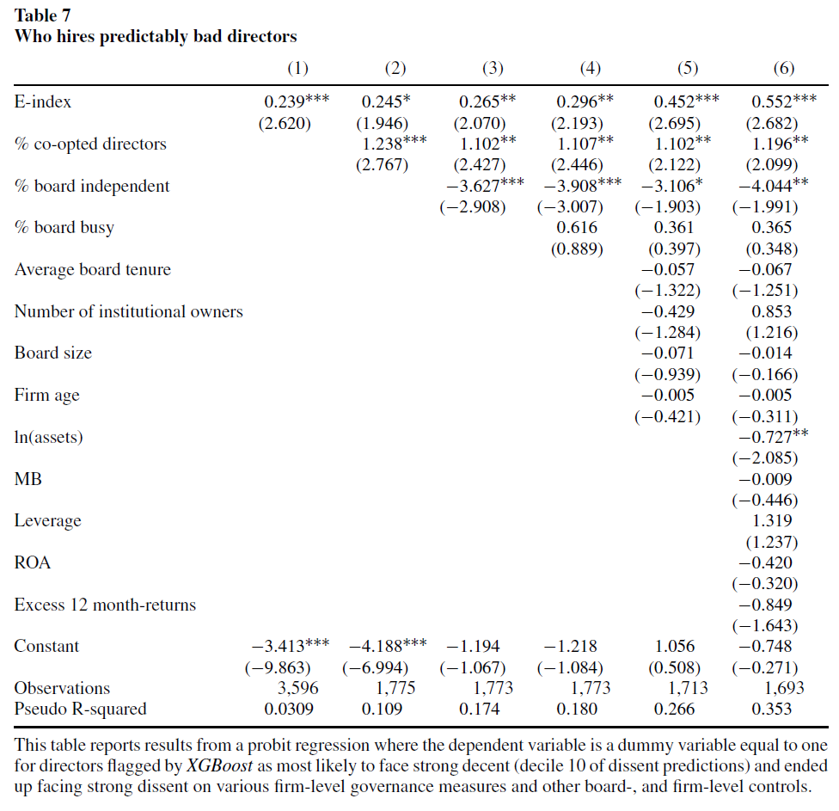
Notes:
E-index increases as the firm-level governance worsens.

Slide 18
Conclusion
The authors:
evaluate the possibility of constructing an algorithm that can predict whether a particular individual will be successful as a director in a particular firm.
compare alternative approaches to forecasting director performance; in particular, how machine learning techniques compare with OLS to predict director performance.
identify characteristics that tend to be associated with effective directors.
use the selections from the algorithms as benchmarks to understand the process through which directors are chosen and identify the types of individuals who are more likely to be poor directors but who are nonetheless selected.

